Slide 1
Sign Language Detection
Team: Vision of Sauron
Abel Asfaw
Hilarion Reyes
Mosunmola Oyeleye
Mya Thanegi Soe
Giovan Panzanella

Slide 2
Table of Contents
Problem Definition
Dataset Overview
EDA
Models
Further Improvements
Conclusion

Slide 3
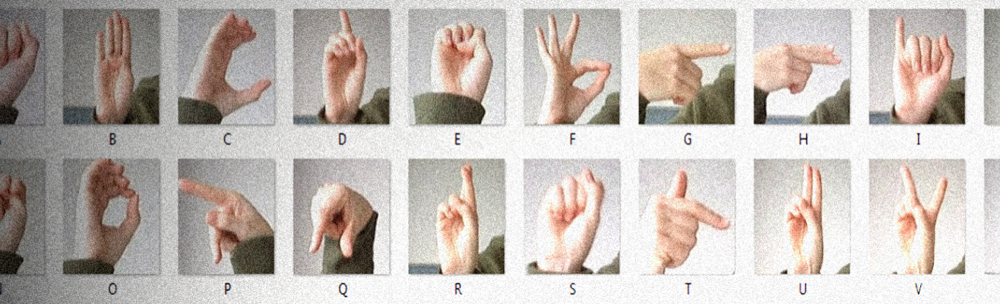
Problem Definition
The deaf or humans with hearing problems don’t have efficient applications that can be used to communicate
Current visual recognition algorithms have issues with real world application
American Sign Language is a complex language and primary language for deaf people.

Slide 4
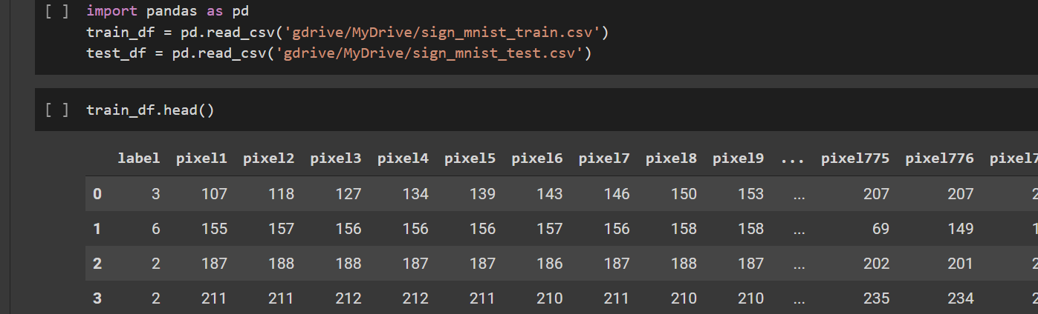
Dataset Overview
Training and test set contain a label ( 0-25) and letters (A-Z)
Match the patterns of the MNIST dataset
Each pixel is of size 28*28
Each sample has 784 pixels

Slide 5
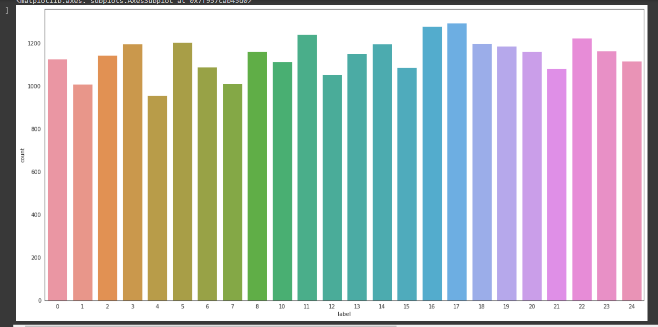
EDA
Label Count ( How many times each letter appears)
0 – 25 is mapped to A-Z
J and Z require motion
There is no count for 9 = J and 25 = Z
Highest count is Q

Slide 6
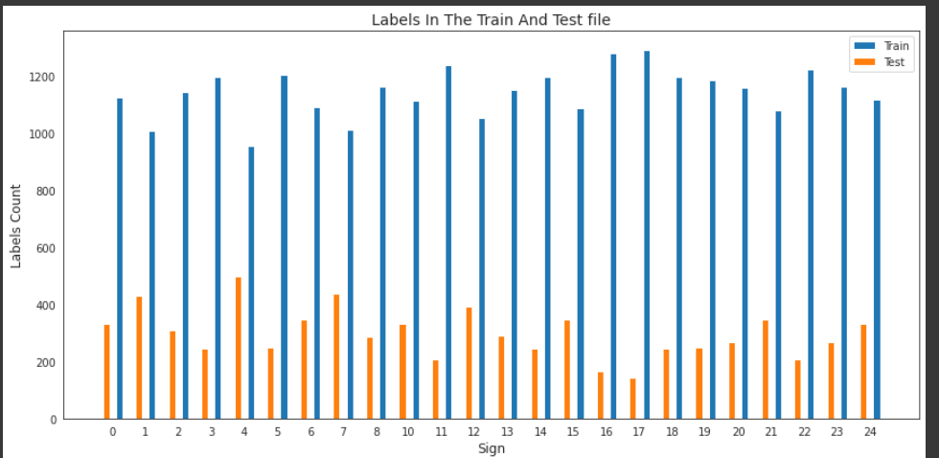
EDA 2:

Slide 7
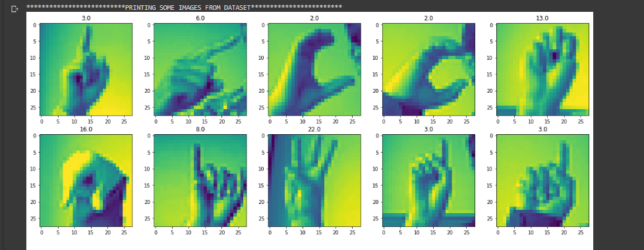
Images from Dataset

Slide 8
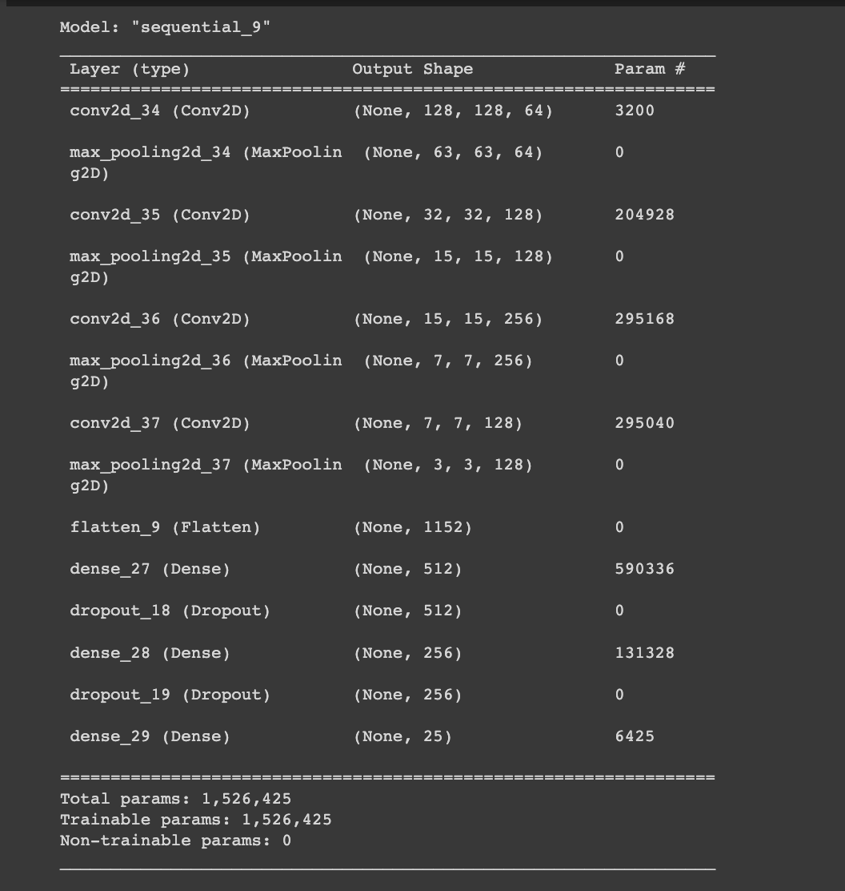
Model 1: SGD Architecture
Built a custom SGD model using Convolution2D Layers and Dense Layers with a total of 1,526,425 trainable params.
Used Max-pooling, Dropout, and Decay for Regularization..
Notes:
Chapter 8 + 9: 10 minutes time + make dataset bigger (image augmentation);

Slide 9
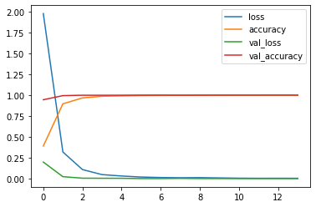
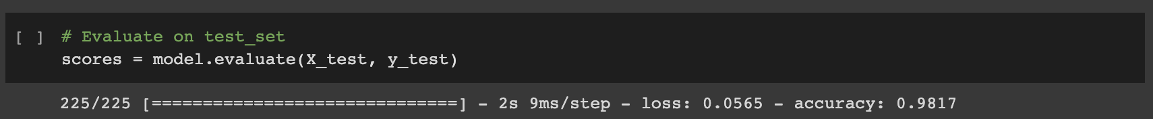
Model 1: SGD Results

Slide 10
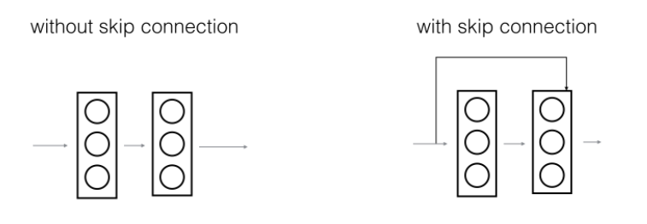
Model 2: Pretrained Resnet Model
Introduced by Microsoft Research
Increasing network depth does not work by simply stacking layers together.
applies concept of skip connection
avoid small gradients by allowing this alternate shortcut path for gradient to flow through
recommended to have a minimum shape of 32,32, (+ #of feature channels)

Slide 11
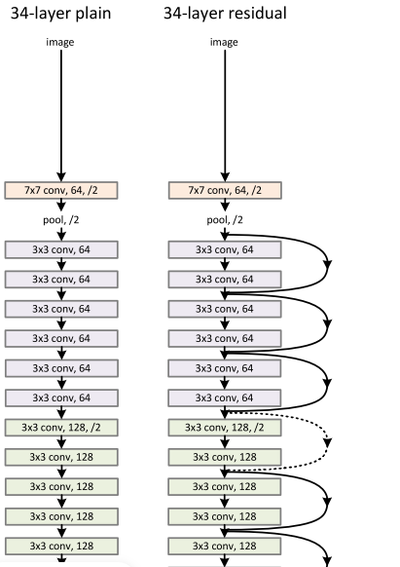
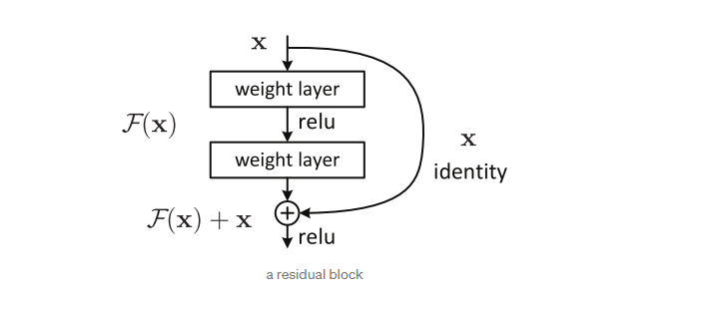
Model 2: Resnet Architecture

Slide 12
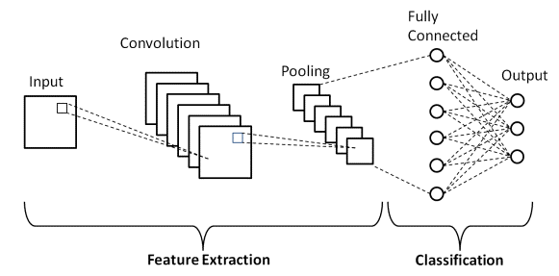
Model 3: Custom Model RMSprop CNN
most commonly applied to analyze visual imagery
CNNs are regularized versions of multilayer perceptrons.
Multilayer perceptrons usually mean fully connected networks.
Each neuron in one layer is connected to all neurons in the next layer.

Slide 13
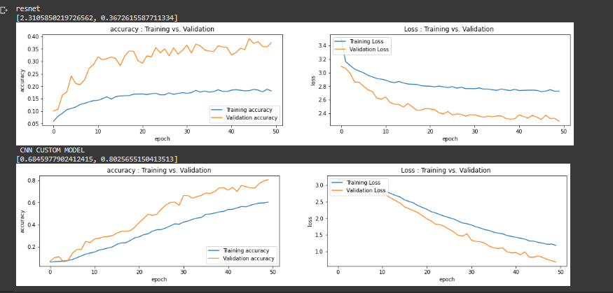
Model 2 + 3 results: RMSprop CNN VS RESNET

Slide 14
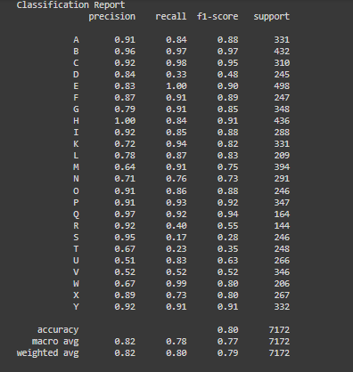
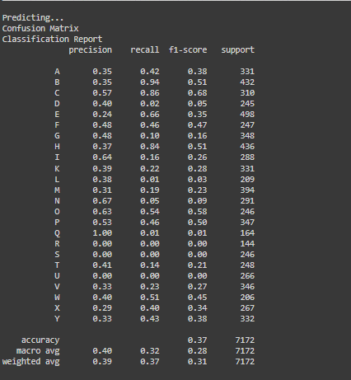
Model Accuracy: CNN VS RESNET

Slide 15
Resnet drawbacks
requires higher image sizes
lower performance compared to a cnn model
Increased complexity of architecture
Computationally expensive
There is no specific rule for determining the structure of a neural network.

Slide 16
CNN drawbacks
Lots of training data is required.
CNN do not encode the position and orientation of object.
There is no specific rule for determining the structure of a neural network.

Slide 17

VIDEO DEMO (using SGD model)

Slide 18
Further Possible Improvements:
Expand diversity of dataset by getting different individuals to model letter types (excluding J and Z which require motion).
potential factors: size of hand, colour of hand
Implement Data Augmentation (rotations, flipping, etc..) to improve model robustness .
Increase image sizes to improve training generalization and improve live-testing accuracy.
Continue fine-tuning the Hyperparameters and the complexity of the hidden layers in order to optimize models’ performance.

Slide 19
In Conclusion
Our code configuration was able to reasonably capture dynamic webcam data from user using openCV to use for our model’s prediction algorithm.
Further improvements must be made to increase model accuracy, improve generalization in order to enhance communication for individuals with hearing impairment and build a more inclusive society.

